Slide 1
Introduction to Software Testing
Module 4
Input Space Partition Testing

Slide 2
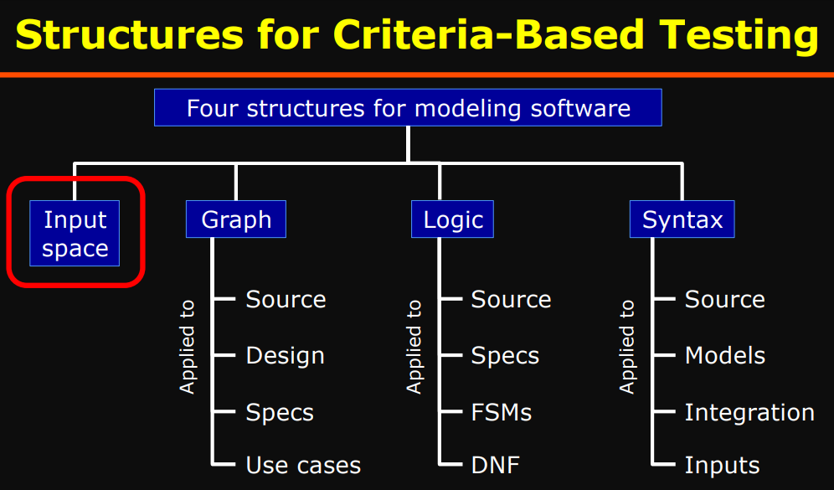


Slide 3
Input Domains
The input domain for a program contains all the possible inputs to that program
For even small programs, the input domain is so large that it might as well be infinite
Testing is fundamentally about choosing finite sets of values from the input domain
Input parameters define the scope of the input domain
  Parameters to a method
  Data read from a file
  Global variables
  User level inputs
Domain for each input parameter is partitioned into regions
At least one value is chosen from each region

Slide 4
Benefits of ISP
Can be equally applied at several levels of testing
  Unit
  Integration
  System
Relatively easy to apply with no automation
Easy to adjust the procedure to get more or fewer tests
No implementation knowledge is needed
  just the input space

Slide 5
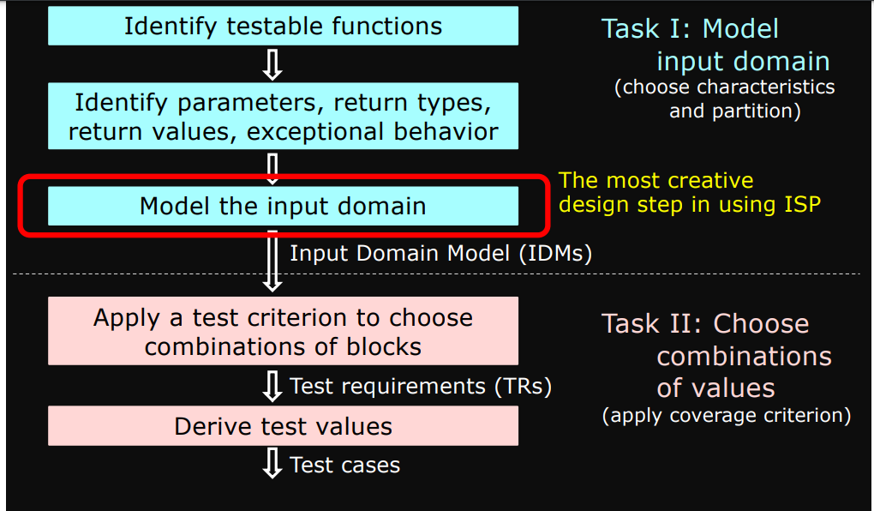
ISP
Input space partitioning describes the input domain of the software
• Domain (D) are partitioned into blocks (b1, b2, .., bn)

Slide 6




Partitioning Domains
Domain D
Partition scheme q of D
The partition q defines a set of blocks, Bq = b₁ , b₂ , … b_{Q}
The partition must satisfy two properties :
  blocks must be pairwise disjoint (no overlap)
  together the blocks cover the domain D (complete)
∪ b = D
b ∈ Bq

Slide 7
Using Partitions – Assumptions
Choose a value from each block
Each value is assumed to be equally useful for testing
Application to testing
  Find characteristics in the inputs : parameters, semantic descriptions, …
  Partition each characteristic
  Choose tests by combining values from characteristics
Example Characteristics
  Input X is null
  Order of the input file F (sorted, inverse sorted, arbitrary, …)
  Min separation of two aircraft
  Input device (DVD, CD, VCR, computer, …)

Slide 8
Choosing Partitions
Choosing (or defining) partitions seems easy, but is easy to get wrong
Consider the “order of file F”
Solution:
Each characteristic should address just one property
b₁ = sorted in ascending order
b₂ = sorted in descending order
b₃ = arbitrary order
File F sorted ascending
- b1 = true
- b2 = false
File F sorted descending
- b1 = true
- b2 = false
but … something’s fishy …
What if the file is of length 1?
The file will be in all three blocks …
That is, disjointness is not satisfied

Slide 9
Properties of Partitions
If the partitions are not complete or disjoint, that means the partitions have not been considered carefully enough
They should be reviewed carefully, like any design attempt
Different alternatives should be considered
We model the input domain in five steps …

Slide 10
Modeling the Input Domain
Step 1 : Identify testable functions
  Individual methods have one testable function
  In a class, each method often has the same characteristics
  Programs have more complicated characteristics—modeling documents such as UML use cases can be used to design characteristics
  Systems of integrated hardware and software components can use devices, operating systems, hardware platforms, browsers, etc
Step 2 : Find all the parameters
  Often fairly straightforward, even mechanical
  Important to be complete
  Methods : Parameters and state (non-local) variables used
  Components : Parameters to methods and state variables
  System : All inputs, including files and databases

Slide 11
Modeling the Input Domain (cont)
Step 3 : Model the input domain
  The domain is scoped by the parameters
  The structure is defined in terms of characteristics
  Each characteristic is partitioned into sets of blocks
  Each block represents a set of values
  This is the most creative design step in using ISP
Step 4 : Apply a test criterion to choose combinations of values
  A test input has a value for each parameter
  One block for each characteristic
  Choosing all combinations is usually infeasible
  Coverage criteria allow subsets to be chosen
Step 5 : Refine combinations of blocks into test inputs
  Choose appropriate values from each block

Slide 12
Two Approaches to Input Domain Modeling
Interface-based approach
  Develops characteristics directly from individual input parameters
  Simplest application
  Can be partially automated in some situations
Functionality-based approach
  Develops characteristics from a behavioral view of the program under test
  Harder to develop—requires more design effort
  May result in better tests, or fewer tests that are as effective
Input Domain Model (IDM)

Slide 13
1. Interface-Based Approach
Mechanically consider each parameter in isolation
This is an easy modeling technique and relies mostly on syntax
Some domain and semantic information won’t be used
  Could lead to an incomplete IDM
Ignores relationships among parameters

Slide 14
2. Functionality-Based Approach
Identify characteristics that correspond to the intended functionality
Requires more design effort from tester
Can incorporate domain and semantic knowledge
Can use relationships among parameters
Modeling can be based on requirements, not implementation
The same parameter may appear in multiple characteristics, so it’s harder to translate values to test cases

Slide 15
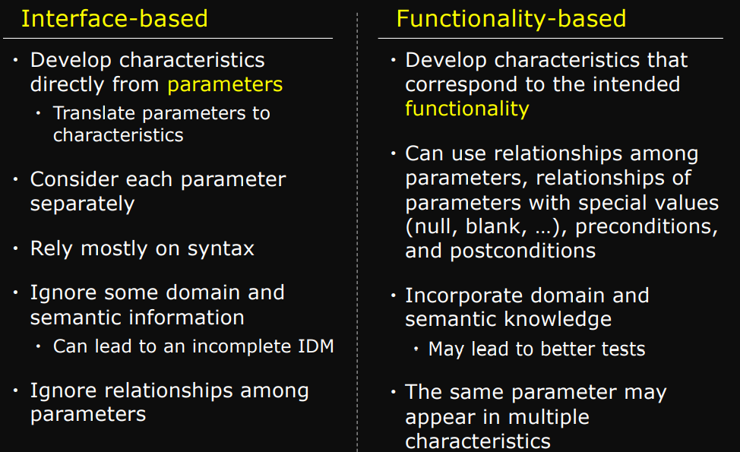

Slide 16
Steps 1 & 2 – Identifying Functionalities, Parameters and Characteristics
A creative engineering step
More characteristics means more tests
Interface-based : Translate parameters to characteristics
Candidates for characteristics :
  Preconditions and postconditions
  Relationships among variables
  Relationship of variables with special values (zero, null, blank, …)
Should not use program source – characteristics should be based on the input domain
  Program source should be used with graph or logic criteria
Better to have more characteristics with few blocks
  Fewer mistakes and fewer tests

Slide 17
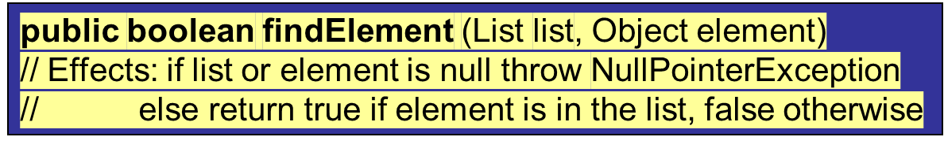
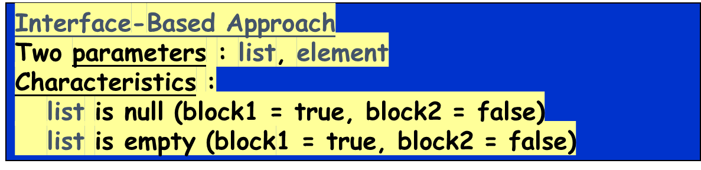
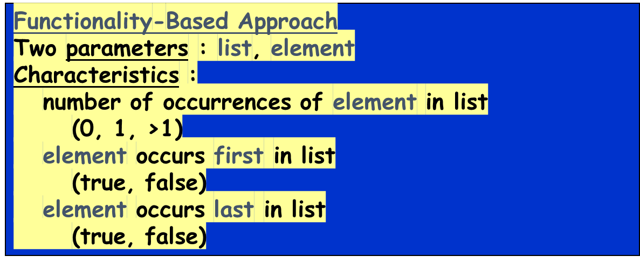
Steps 1 & 2 : Interface vs Functionality-Based

Slide 18
Step 3 : Modeling the Input Domain
Partitioning characteristics into blocks and values is a very creative engineering step
More blocks means more tests
The partitioning often flows directly from the definition of characteristics and both steps are sometimes done together
  Should evaluate them separately – sometimes fewer characteristics can be used with more blocks and vice versa
Strategies for identifying values :
  Include valid, invalid and special values
  Sub-partition some blocks
  Explore boundaries of domains
  Include values that represent “normal use”
  Try to balance the number of blocks in each characteristic
  Check for completeness and disjointness

Slide 19

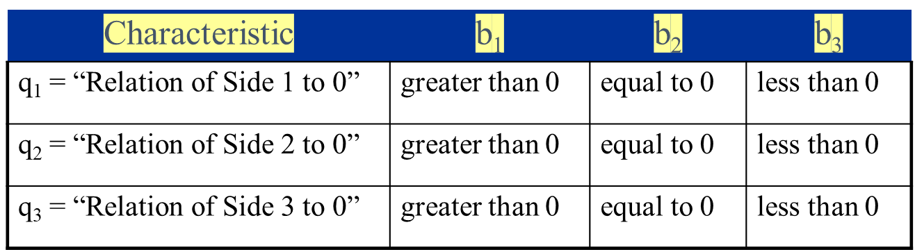
Interface-Based IDM – TriTyp
TriTyp, from Chapter 3, had one testable function and three integer inputs
A maximum of 3*3*3 = 27 tests
Some triangles are valid, some are invalid
Refining the characterization can lead to more tests …

Slide 20
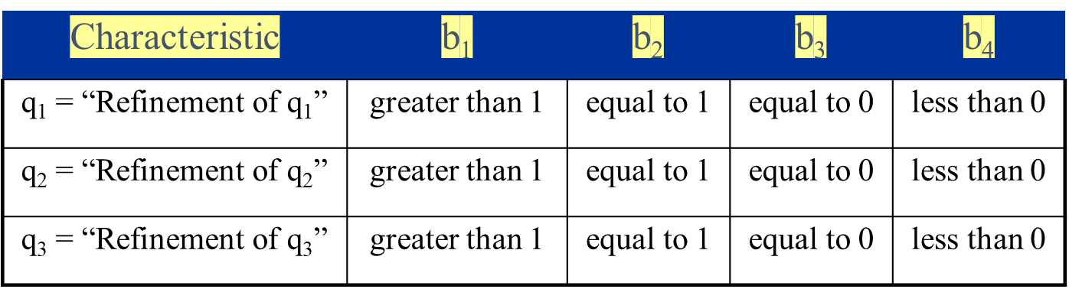
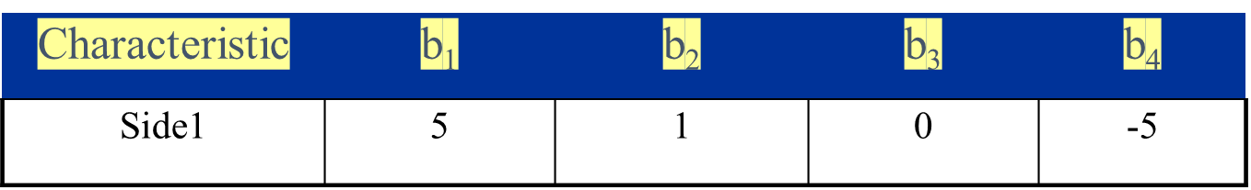



Interface-Based IDM – TriTyp (cont)
Second Characterization of TriTyp’s Inputs
A maximum of 4*4*4 = 64 tests
This is only complete because the inputs are integers (0 . . 1)

Slide 21
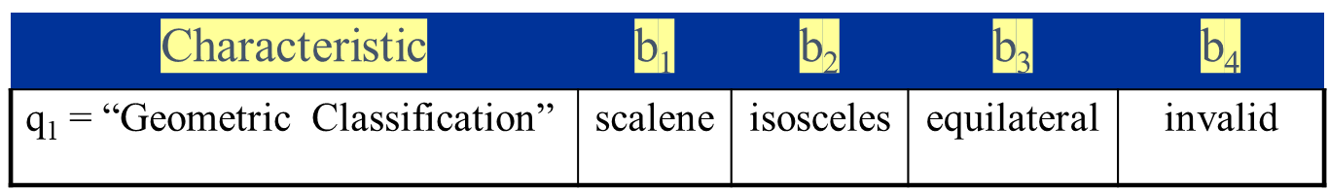
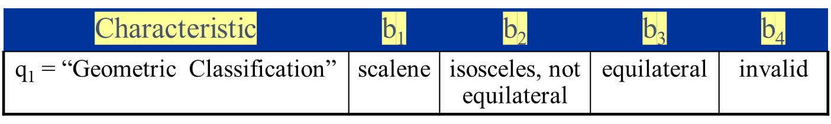
Functionality-Based IDM – TriTyp
First two characterizations are based on syntax–parameters and their type
A semantic level characterization could use the fact that the three integers represent a triangle
Oops … something’s fishy … equilateral is also isosceles !
We need to refine the example to make characteristics valid

Slide 22
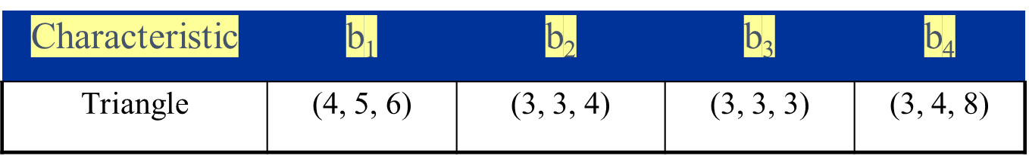
Functionality-Based IDM – TriTyp (cont)
Values for this partitioning can be chosen as

Slide 23
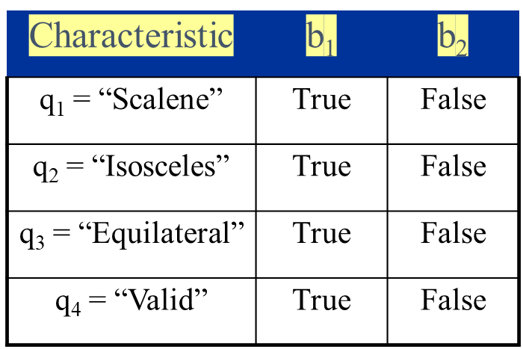
Functionality-Based IDM – TriTyp (cont)
A different approach would be to break the geometric characterization into four separate characteristics
Use constraints to ensure that
  Equilateral = True implies Isosceles = True
  Valid = False implies Scalene = Isosceles = Equilateral = False

Slide 24
Using More than One IDM
Some programs may have dozens or even hundreds of parameters
Create several small IDMs
  A divide-and-conquer approach
Different parts of the software can be tested with different amounts of rigor
  For example, some IDMs may include a lot of invalid values
It is okay if the different IDMs overlap
  The same variable may appear in more than one IDM

Slide 25
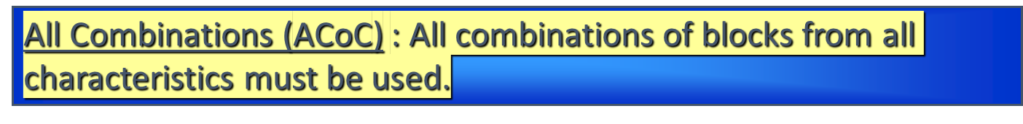
Step 4 – Choosing Combinations of Values
Once characteristics and partitions are defined, the next step is to choose test values
We use criteria – to choose effective subsets
The most obvious criterion is to choose all combinations …
Number of tests is the product of the number of blocks in each characteristic :
Π
Q
(B_{i})
i=1
The second characterization of TriTyp results in 4*4*4 = 64 tests – too many ?

Slide 26
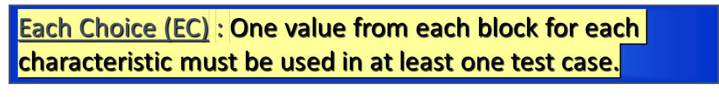
ISP Criteria – Each Choice
64 tests for TriTyp is almost certainly way too many
One criterion comes from the idea that we should try at least one value from each block
Number of tests is the number of blocks in the largest characteristic
Max
Q
(B_{i})
i=1
For TriTyp: 2, 2, 2
1, 1, 1
0, 0, 0
-1, -1, -1

Slide 27
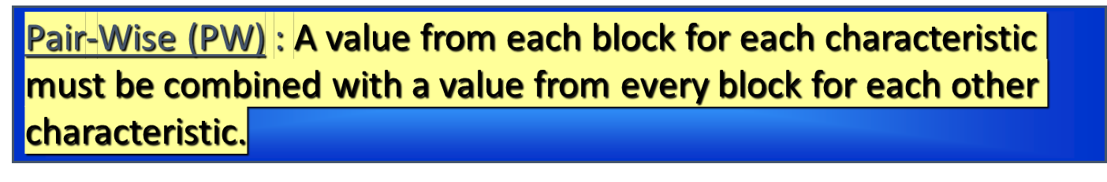
ISP Criteria – Pair-Wise
Each choice yields few tests – cheap but perhaps ineffective
Another approach asks values to be combined with other values
Number of tests is at least the product of two largest characteristics
(Max
Q
(B_{i})
) *
(Max
Q
)
(B_{j})
i=1
j=1, j!=i
For TriTyp: 2, 2, 2 2, 1, 1 2, 0, 0 2, -1, -1
1, 2, 1 1, 1, 0 1, 0, -1 1, -1, 2
0, 2, 0 0, 1, -1 0, 0, 2 0, -1, 1
-1, 2, -1 -1, 1, 2 -1, 0, 1 -1, -1, 0

Slide 28

ISP Criteria –T-Wise
A natural extension is to require combinations of t values instead of 2
Number of tests is at least the product of t largest characteristics
If all characteristics are the same size, the formula is
(Max
Q
)
(B_{i})
t
i=1
If t is the number of characteristics Q, then all combinations
That is … Q-wise = AC
t-wise is expensive and benefits are not clear

Slide 29
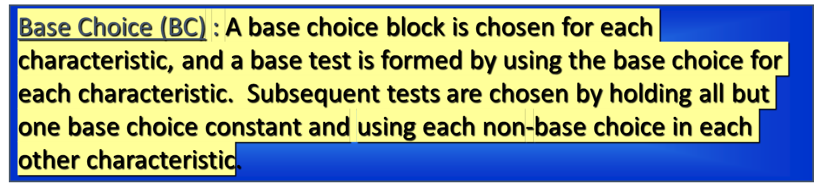
ISP Criteria – Base Choice
Testers sometimes recognize that certain values are important
This uses domain knowledge of the program
Number of tests is one base test + one test for each other block
1 + ∑
Q
(B_{i} -1 )
i=1
For TriTyp: Base 2, 2, 2 2, 2, 1 2, 1, 2 1, 2, 2
2, 2, 0 2, 0, 2 0, 2, 2
2, 2, -1 2, -1, 2 -1, 2, 2

Slide 30
Base Choice Notes
The base test must be feasible
  That is, all base choices must be compatible
Base choices can be
  Most likely from an end-use point of view
  Simplest
  Smallest
  First in some ordering
The base choice is a crucial design decision
  Test designers should document why the choices were made

Slide 31
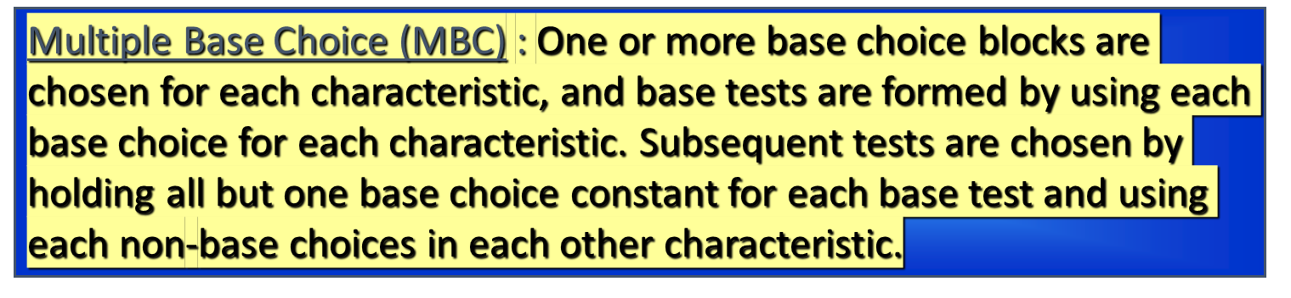
ISP Criteria – Multiple Base Choice
Testers sometimes have more than one logical base choice
If there are M base tests and m_{i} base choices for each characteristic:
M + ∑
Q
(M * (B_{i} - m_{i} ))
i=1
For TriTyp: Base
2, 2, 2 2, 2, 0 2, 0, 2 0, 2, 2
2, 2, -1 2, -1, 2 -1, 2, 2
1, 1, 1 1, 1, 0 1, 0, 1 0, 1, 1
1, 1, -1 1, -1, 1 -1, 1, 1

Slide 32






ISP Coverage Criteria Subsumption

Slide 33
Constraints Among Characteristics
Some combinations of blocks are infeasible
  “less than zero” and “scalene” … not possible at the same time
These are represented as constraints among blocks
Two general types of constraints
  A block from one characteristic cannot be combined with a specific block from another
  A block from one characteristic can ONLY BE combined with a specific block form another characteristic
Handling constraints depends on the criterion used
  AC, PW, TW : Drop the infeasible pairs
  BC, MBC : Change a value to another non-base choice to find a feasible combination

Slide 34
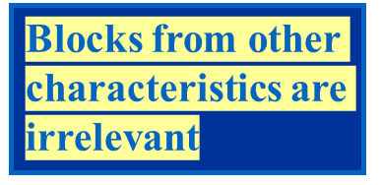
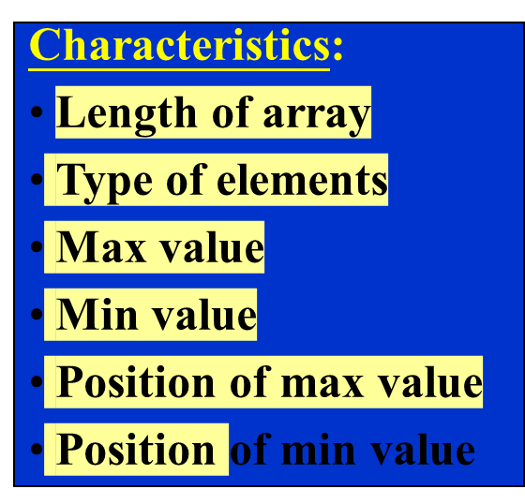
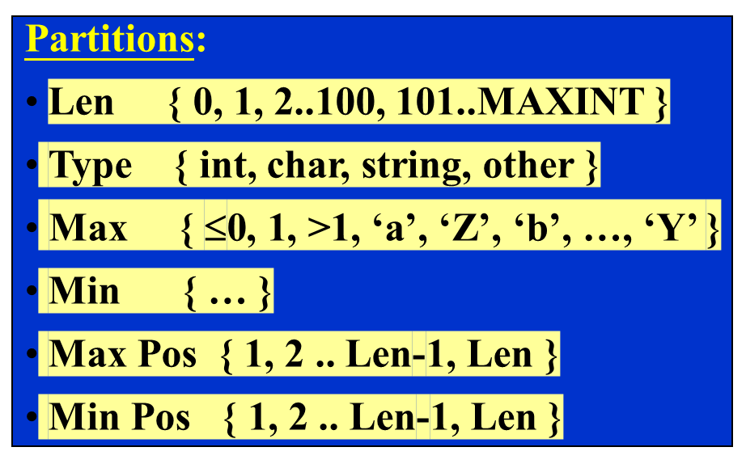


Example Handling Constraints
Sorting an array
  Input : variable length array of arbitrary type
  Outputs : sorted array, largest value, smallest value

Slide 35
Input Space Partitioning Summary
Fairly easy to apply, even with no automation
Convenient ways to add more or less testing
Applicable to all levels of testing – unit, class, integration, system, etc.
Based only on the input space of the program, not the implementation
Simple, straightforward, effective, and widely used in practice

Slide 36
Problem
Consider a simple program to classify a triangle. Its input consists of three positive integers (say x, y, z) and the data types for input parameters ensures that these will be integers greater than zero and less than or equal to 100. The three values are interpreted as representing the lengths of the sides of a triangle. The program then prints a message to the standard output that states whether the triangle, if it can be formed, is scalene, isosceles, equilateral, or right-angled

Slide 37
Solution: Following possible boundary conditions are formed:
1. Given sides (A; B; C) for a scalene triangle, the sum of any two sides is greater than the third and so, we have boundary conditions A + B > C, B + C > A and A+ C > B.
2. Given sides (A; B; C) for an isosceles triangle two sides must be equal and so we have boundary conditions A = B, B = C or A = C.
3. Continuing in the same way for an equilateral triangle the sides must all be of equal length and we have only one boundary where A = B = C.
4. For right-angled triangles, we must have A ²+B²= C ²

Slide 38
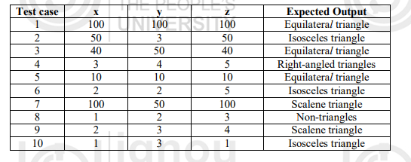
On the basis of the above boundary conditions, test cases are designed as follows

Slide 39
Functional Testing
FUNCTIONAL TESTING is a type of software testing that validates the software system against the functional requirements/specifications.
The purpose of Functional tests is to test each function of the software application, by providing appropriate input, verifying the output against the Functional requirements.
Functional testing mainly involves black box testing and it is not concerned about the source code of the application.
This testing checks User Interface, APIs, Database, Security, Client/Server communication and other functionality of the Application Under Test.
The testing can be done either manually or using automation.

Slide 40
What do you test in Functional Testing?
The prime objective of Functional testing is checking the functionalities of the software system. It mainly concentrates on –
Mainline functions: Testing the main functions of an application
Basic Usability: It involves basic usability testing of the system. It checks whether a user can freely navigate through the screens without any difficulties.
Accessibility: Checks the accessibility of the system for the user
Error Conditions: Usage of testing techniques to check for error conditions. It checks whether suitable error messages are displayed.

Slide 41
How to do Functional Testing
Following is a step by step process on How to do Functional Testing :
Understand the Functional Requirements
Identify test input or test data based on requirements
Compute the expected outcomes with selected test input values
Execute test cases
Compare actual and computed expected results

Slide 42
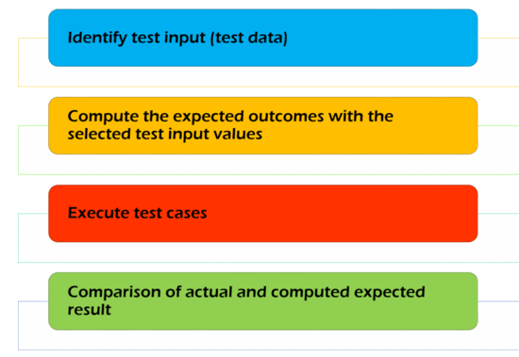

Slide 43
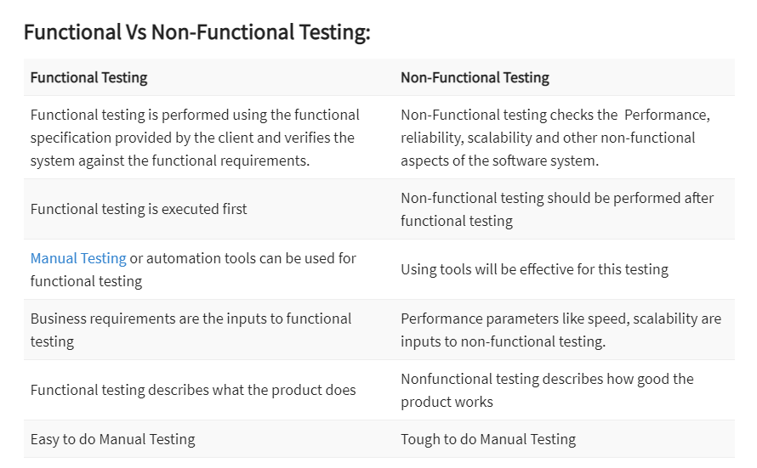

Slide 44
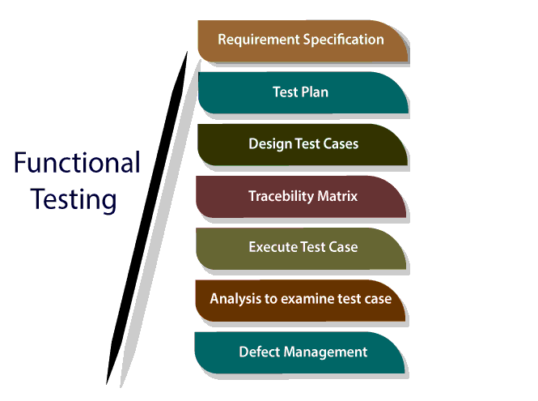

Slide 45
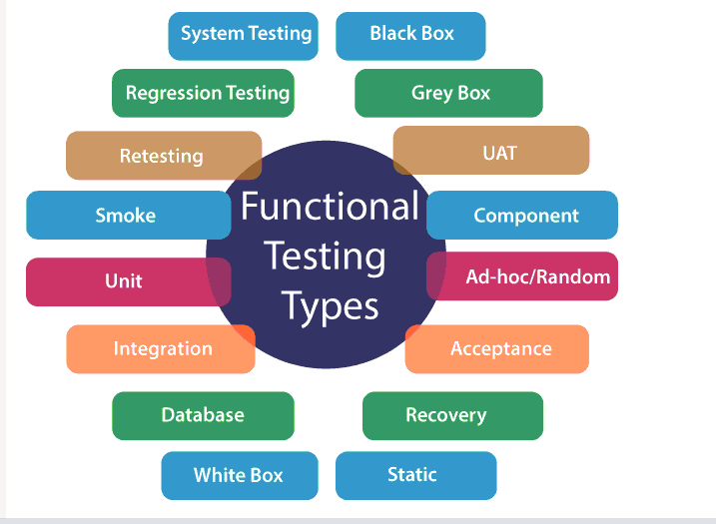
Explain the types of functional testing.

Slide 46
Functional Testing Concepts of Howden
The four key concepts in functional testing are:
Precisely identify the domain of each input and each output variable
Select values from the data domain of each variable having important properties
Consider combinations of special values from different input domains to design test cases
Consider input values such that the program under test produces special values from the domains of the output variables

Slide 47
Different Types of Variables
Numeric Variables
  A set of discrete values
  A few contiguous segments of values
Arrays
  An array holds values of the same type, such as integer and real. Individual elements of an array are accessed by using one or more indices.
Substructures
  A structure means a data type that can hold multiple data elements. In the field of numerical analysis, matrix structure is commonly used.
Subroutine Arguments
  Some programs accept input variables whose values are the names of functions. Such programs are found in numerical analysis and statistical applications
Notes:
Handouts

Slide 48
Test Vectors
A test vector is an instance of an input to a program, a.k.a. test data
If a program has n input variables, each of which can take on k special values, then there are k^{n} possible combinations of test vectors
We have more than one million test vectors even for k = 3 and n = 20
There is a need to identify a method for reducing the number of test vectors
Howden suggested that there is no need of combining values of all input variables to design a test vector, if the variables are not functionally related
It is difficult to give a formal definition of the idea of functionally related variables, but it is easy to identify them
  Variables appearing in the same assignment statement are functionally related
  Variables appearing in the same branch predicate – the condition part of an if statement, for example – are functionally related
Notes:
Handouts

Slide 49
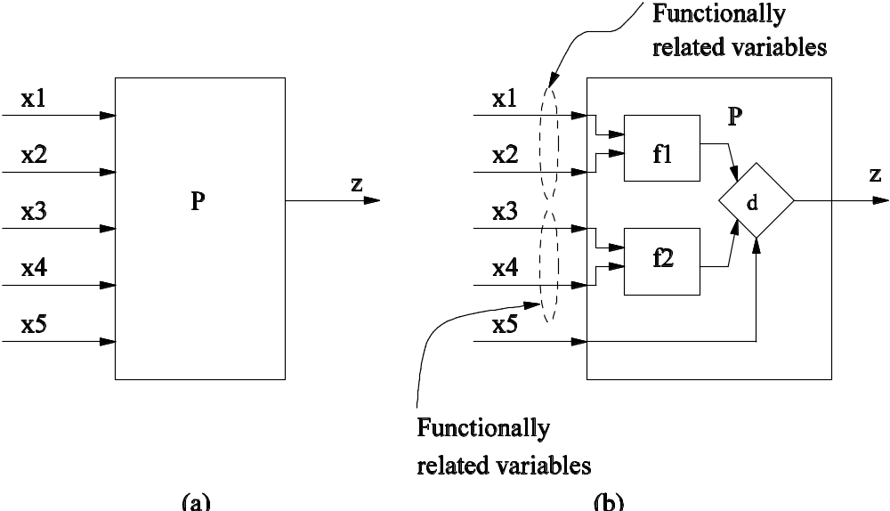
Test Vectors
Example of functionality related variables
Figure 9.3: Functionality related variables
Notes:
Handouts

Slide 50
Howden’s Functional Testing Summary
Let us summarize the main points in functional testing:
Identify the input and the output variables of the program and their data domains
Compute the expected outcomes as illustrated in Figure 9.5(a), for selected input values
Determine the input values that will cause the program to produce selected outputs as illustrated in Figure 9.5(b).
Notes:
Handouts

Slide 51
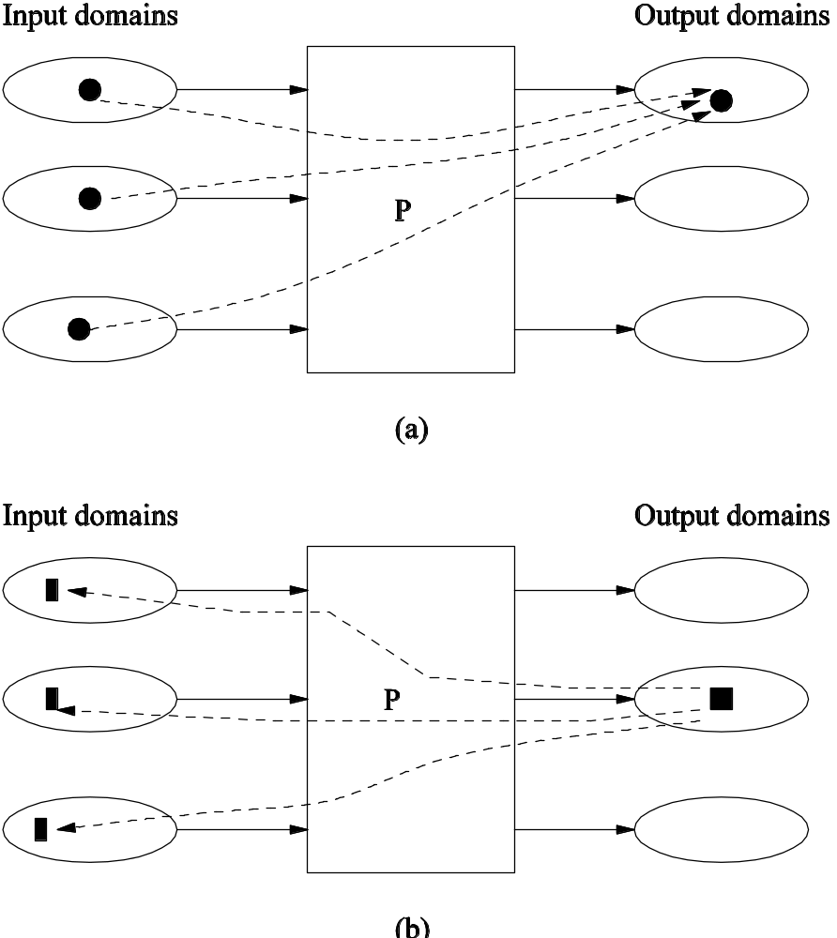
Howden’s Functional Testing Summary
Figure 9.5: Obtaining output values from an input vector (a), and obtaining an input vector from an output value (b) in functional testing
Notes:
Handouts

Slide 52
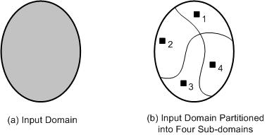
Equivalence Class Partitioning
An input domain may be too large for all its elements to be used as test input (Figure 9.8(a))
The input domain is partitioned into a finite number of subdomains
Each subdomain is known as an equivalence class, and it serves as a source of at least one test input (Figure 9.8(b))
A valid input to a system is an element of the input domain that is expected to return a non error value
An invalid input is an input that is expected to return an error value.
Figure 9.8: (a) Too many test input; (b) One input is selected from each of the subdomain
Notes:
Handouts

Slide 53
Guidelines for Equivalence Class Partitioning
An input condition specifies a range [a, b]
  one equivalence class for a < X < b, and
  two other classes for X < a and X > b to test the system with invalid inputs
An input condition specifies a set of values
  one equivalence class for each element of the set {M₁}, {M₂}, ...., {M_{N}}, and
  one equivalence class for elements outside the set {M₁,M₂, ...,M_{N}}
Input condition specifies for each individual value
  If the system handles each valid input differently then create one equivalence class for each valid input
An input condition specifies the number of valid values (Say N)
  Create one equivalence class for the correct number of inputs
  two equivalence classes for invalid inputs – one for zero values and one for more than N values
An input condition specifies a “must be” value
  Create one equivalence class for a “must be” value, and
  one equivalence class for something that is not a “must be” value
Notes:
Handouts

Slide 54
Identification of Test Cases
Test cases for each equivalence class can be identified by:
Assign a unique number to each equivalence class
For each equivalence class with valid input that has not been covered by test cases yet, write a new test case covering as many uncovered equivalence classes as possible
For each equivalence class with invalid input that has not been covered by test cases, write a new test case that covers one and only one of the uncovered equivalence classes
Notes:
Handouts

Slide 55
Advantages of Equivalence Class Partitioning
A small number of test cases are needed to adequately cover a large input domain
One gets a better idea about the input domain being covered with the selected test cases
The probability of uncovering defects with the selected test cases based on equivalence class partitioning is higher than that with a randomly chosen test suite of the same size
The equivalence class partitioning approach is not restricted to input conditions alone – the technique may also be used for output domains
Notes:
Handouts

Slide 56
Boundary Value Analysis (BVA)
The central idea in Boundary Value Analysis (BVA) is to select test data near the boundary of a data domain so that data both within and outside an equivalence class are selected
The BVA technique is an extension and refinement of the equivalence class partitioning technique
In the BVA technique, the boundary conditions for each of the equivalence class are analyzed in order generate test cases
Notes:
Handouts

Slide 57
Guidelines for Boundary Value Analysis
The equivalence class specifies a range
  If an equivalence class specifies a range of values, then construct test cases by considering the boundary points of the range and points just beyond the boundaries of the range
The equivalence class specifies a number of values
  If an equivalence class specifies a number of values, then construct test cases for the minimum and the maximum value of the number
  In addition, select a value smaller than the minimum and a value larger than the maximum value.
The equivalence class specifies an ordered set
  If the equivalence class specifies an ordered set, such as a linear list, table, or a sequential file, then focus attention on the first and last elements of the set.
Notes:
Handouts

Slide 58
Decision Tables
The structure of a decision table has been shown in Table 9.13
It comprises a set of conditions (or, causes) and a set of effects (or, results) arranged in the form of a column on the left of the table
In the second column, next to each condition, we have its possible values: Yes (Y), No (N), and Don’t Care (“-”)
To the right of the “Values” column, we have a set of rules. For each combination of the three conditions {C1,C2,C3}, there exists a rule from the set {R1,R2, ..,R8}
Each rule comprises a Yes (Y), No (N), or Don’t Care (“-”) response, and contains an associated list of effects {E1,E2,E3}
For each relevant effect, an effect sequence number specifies the order in which the effect should be carried out, if the associated set of conditions are satisfied
The “Checksum” is used for verification of the combinations, the decision table represent
Each rule of a decision table represents a test case
Notes:
Handouts

Slide 59
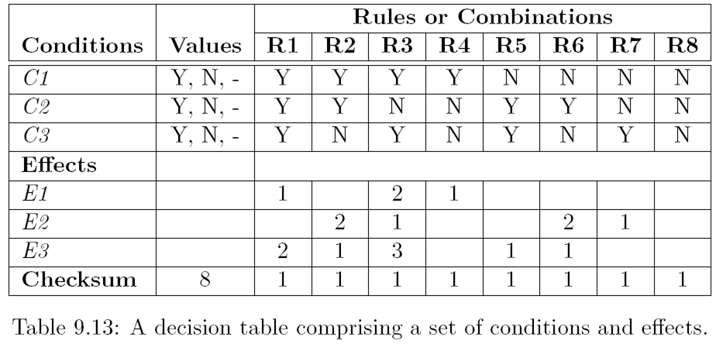
Decision Tables
Notes:
Handouts

Slide 60
Decision Tables
The steps in developing test cases using decision table technique:
Step 1: The test designer needs to identify the conditions and the effects for each specification unit.
  A condition is a distinct input condition or an equivalence class of input conditions
  An effect is an output condition. Determine the logical relationship between the conditions and the effects
Step 2: List all the conditions and effects in the form of a decision table. Write down the values the condition can take
Step 3: Calculate the number of possible combinations. It is equal to the number of different values raised to the power of the number of conditions
Notes:
Handouts

Slide 61
Decision Tables
Step 4: Fill the columns with all possible combinations – each column corresponds to one combination of values. For each row (condition) do the following:
  Determine the Repeating Factor (RF): divide the remaining number of combinations by the number of possible values for that condition
  Write RF times the first value, then RF times the next and so forth, until row is full
Step 5: Reduce combinations (rules). Find indifferent combinations - place a “-” and join column where columns are identical. While doing this, ensure that effects are the same
Step 6: Check covered combinations (rules). For each column calculate the combinations it represents. A “-” represents as many combinations as the condition has. Multiply for each “-” down the column. Add up total and compare with step 3. It should be the same
Step 7: Add effects to the column of the decision table. Read column by column and determine the effects. If more than one effect can occur in a single combinations, then assign a sequence number to the effects, thereby specifying the order in which the effects should be performed. Check the consistency of the decision table
Step 8: The columns in the decision table are transformed into test cases
Notes:
Handouts

Slide 62
Random Testing
In the random testing approach, test inputs are selected randomly from the input domain of the system
Random testing can be summarized as:
  Step 1 : The input domain is identified
  Step 2 : Test inputs are selected independently from the domain
  Step 3 : The system under test is executed on these inputs
    The inputs constitute a random test set
  Step 4 : The results are compared to the system specification.
    The test is a failure if any input leads to incorrect results
    Otherwise it is a success.
Random testing gives us an advantage of easily estimating software reliability from test outcomes
Test inputs are randomly generated according to an operational profile, and failure times are recorded
The data obtained from random testing can then be used to estimate reliability
Notes:
Handouts

Slide 63
Random Testing
Computing expected outcomes becomes difficult, if the inputs are randomly chosen
Therefore, the technique requires good test oracles to ensure the adequate evaluation of test results
A test oracle is a mechanism that verifies the correctness of program outputs
An oracle provides a method to
  generate expected results for the test inputs, and
  compare the expected results with the actual results of execution of the Implementation Under Test (IUT)
Four common types of oracles are as follows:
  Perfect oracle
  Gold standard oracle
  Parametric oracle
  Statistical oracle
Notes:
Handouts

Slide 64
Adaptive Random Testing
In adaptive random testing the test inputs are selected from the randomly generated set in such a way that these are evenly spread over the entire input domain
The goal is to select a small number of test inputs to detect the first failure
A number of random test inputs are generated, then the “best” one among them is selected
We need to make sure the selected new test input should not be too close to any of the previously selected ones
That is, try to distribute the selected test inputs as spaced out as possible
Notes:
Handouts

Slide 65
Error Guessing
It is a test case design technique where a test engineer uses his experience to
  guess the types and probable locations of defects, and
  design tests specifically to reveal the defects
Though experience is of much use in guessing errors, it is useful to add some structure to the technique
It is good to prepare a list of types of errors that can be uncovered
The error list can aid us in guessing where errors may occur. Such a list should be maintained from experience gained from earlier test projects
Notes:
Handouts

Slide 66
Category Partition
The Category Partition Method (CPM) is a systematic, specification based methodology that uses an informal functional specification to produce formal test specification
The test designer’s key job is to develop categories, which are defined to be the major characteristics of the input domain of the function under test
Each category is partitioned into equivalence classes of inputs called choices
The choices in each category must be disjoint, and together the choices in each category must cover the input domain
Notes:
Handouts

Slide 67
Category Partition
The method comprise of the following steps:
Step 1. Analyze the Specification
Step 2. Identify Categories
Step 3. Partition the Categories into Choices
Step 4. Determine Constraints among Choices
Step 5. Formalize and Evaluate the Test Specification
Step 6. Generate and Validate the Test Cases
Notes:
Handouts

